Slide 1

From Moonshot to Mars
Sebastiaan Groot
Marvin Hiemstra
Remy Bien
Wouter Miltenburg
Koen Veelenturf
Ruben Bras
1
Notes:
6/10/13

Slide 2
Table of content
Moonshot
The Assignment
JaNET’s Moonshot
FreeRADIUS Module
Notes:
6/10/13

Slide 3
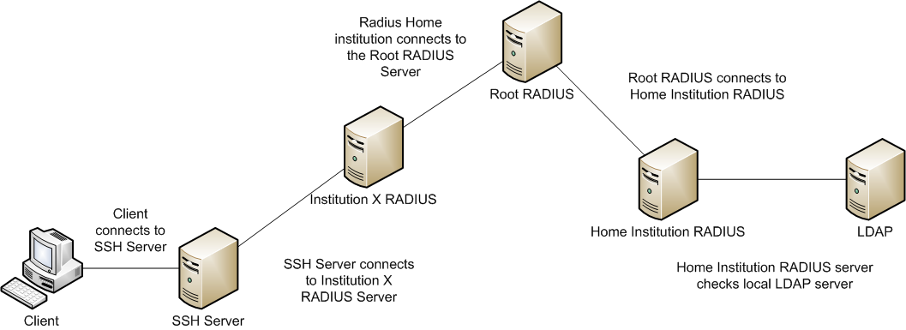
Moonshot
What is Moonshot?
How it should work
Notes:
6/10/13

Slide 4
The Assignment
Goal
Research
Scope
Our Solution
Notes:
6/10/13

Slide 5

JaNET’s Moonshot
JaNET
How does it works?
Progress of JaNET’s Moonshot
Known issues
Notes:
6/10/13

Slide 6
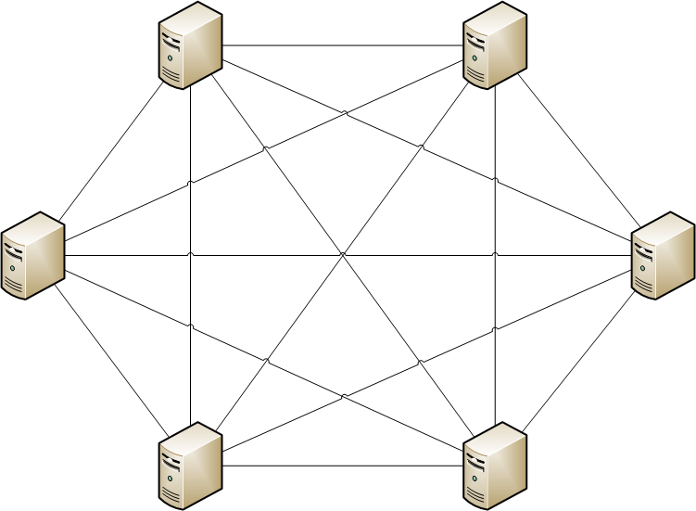
JaNET’s Moonshot: JaNET
Organisatie
Network
Notes:
6/10/13

Slide 7
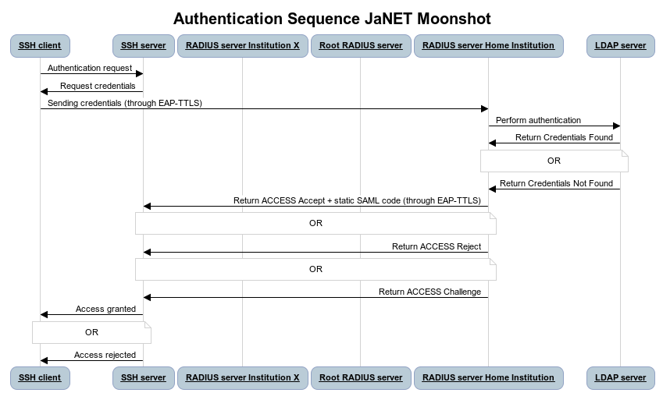
JaNET’s Moonshot: How does it work?
Notes:
6/10/13

Slide 8
JaNET’s Moonshot: Progress of JaNET’s Moonshot
Pilot
Trust-router Beta
Debian “Wheezy” only – CentOS in development
Notes:
6/10/13

Slide 9
JaNET’s Moonshot: Known Issues
Cent-OS
Libevent
GSS-EAP mechanism
Documentation
Notes:
6/10/13

Slide 10

FreeRADIUS Module
Introduction
Protocol specification
Proof of Concept
Future work
Notes:
6/10/13

Slide 11
FreeRADIUS Module: Introduction
Using regular RADIUS traffic
Third-party attribute providers
Easily implemented as modules on existing infrastructures
Notes:
6/10/13

Slide 12
FreeRADIUS Module: Protocol Specification
Three actors
Client
Proxy-RADIUS server
IDP-RADIUS server
Five states
Client: Sending Access-Request
Proxy: Proxying Access-Request
IDP: Evaluating the Access-Request
Proxy: Proxying the repose
Client: Evaluating the respons
Notes:
6/10/13

Slide 13
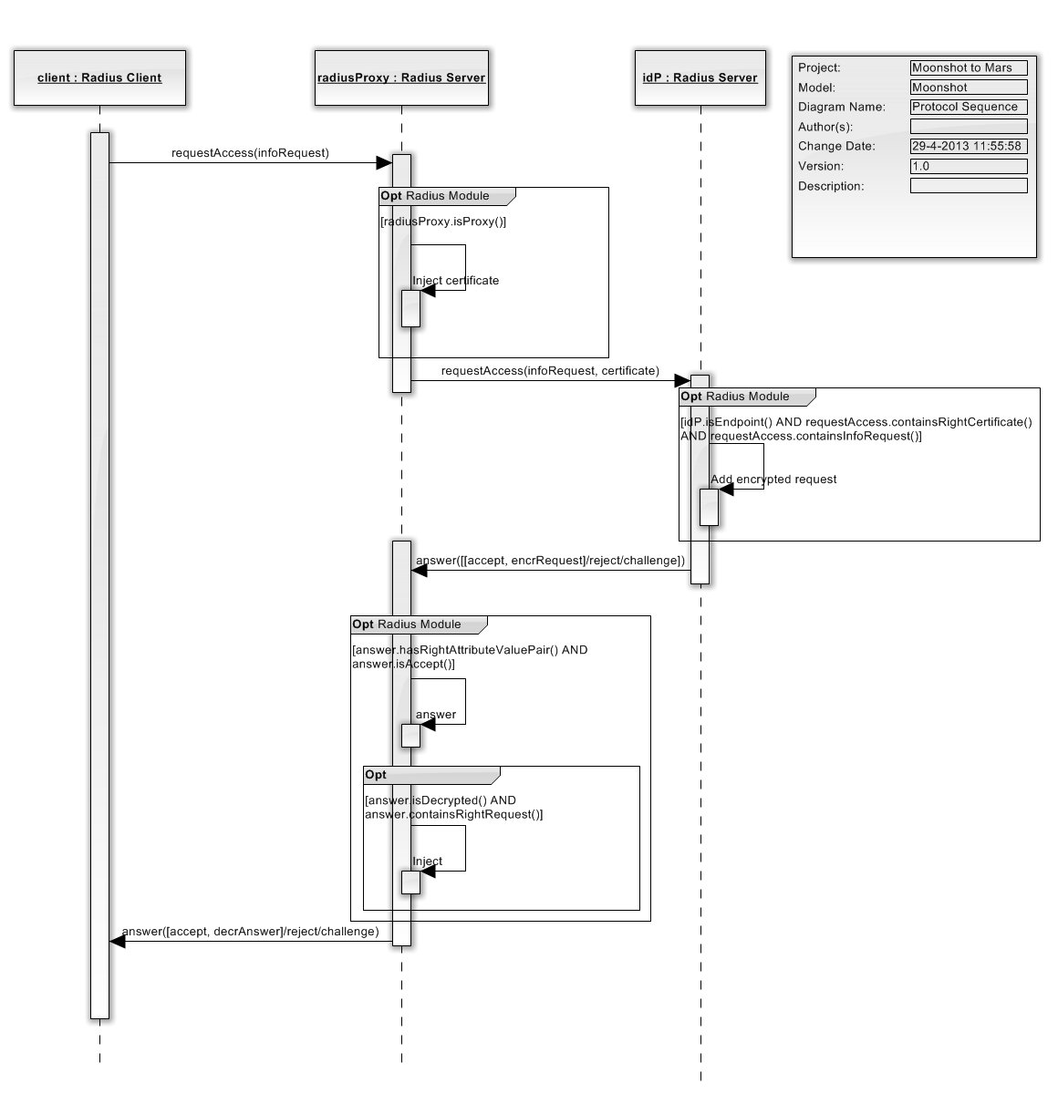

Slide 14
FreeRADIUS Module: Protocol Specification
URN formats:
Client request
Timestamp:Service DN:Proxy DN:Required Attibutes:Requested Attributes
IDP Response
Timestamp:Service DN:IDP DN:Provided AVPs:Requested Attributes
Proxy response
Timestamp:Proxy DN:Requested AVPs
Notes:
6/10/13

Slide 15
12345:DC=HVA,DC=NL,CN=SSHD:DC=SURFNET,DC=NL,CN=SurfConext:2: UserName:SurfConextPassword:1:SurfConextGroup
12352:DC=HVA,DC=NL,CN=SSHD:DC=NIKHEF,DC=NL,CN=RADIUSD:2:UserName=sgroot:SuftConextPassword=testing123:1:SurfConextGroup
12380:DC=SURFNET,DC=NL,CN=SurfConext:1:SurfConextGroup=HvAStudent
Notes:
6/10/13

Slide 16
12345:DC=HVA,DC=NL,CN=SSHD:DC=SURFNET,DC=NL,CN=SurfConext:2: UserName:SurfConextPassword:1:SurfConextGroup
12352:DC=HVA,DC=NL,CN=SSHD:DC=NIKHEF,DC=NL,CN=RADIUSD:2:UserName=sgroot:SuftConextPassword=testing123:1:SurfConextGroup
12380:DC=SURFNET,DC=NL,CN=SurfConext:1:SurfConextGroup=HvAStudent
Notes:
6/10/13

Slide 17
12345:DC=HVA,DC=NL,CN=SSHD:DC=SURFNET,DC=NL,CN=SurfConext:2: UserName:SurfConextPassword:1:SurfConextGroup
12352:DC=HVA,DC=NL,CN=SSHD:DC=NIKHEF,DC=NL,CN=RADIUSD:2:UserName=sgroot:SuftConextPassword=testing123:1:SurfConextGroup
12380:DC=SURFNET,DC=NL,CN=SurfConext:1:SurfConextGroup=HvAStudent
Notes:
6/10/13

Slide 18
12345:DC=HVA,DC=NL,CN=SSHD:DC=SURFNET,DC=NL,CN=SurfConext:2: UserName:SurfConextPassword:1:SurfConextGroup
12352:DC=HVA,DC=NL,CN=SSHD:DC=NIKHEF,DC=NL,CN=RADIUSD:2:UserName=sgroot:SuftConextPassword=testing123:1:SurfConextGroup
12380:DC=SURFNET,DC=NL,CN=SurfConext:1:SurfConextGroup=HvAStudent
Notes:
6/10/13

Slide 19
12345:DC=HVA,DC=NL,CN=SSHD:DC=SURFNET,DC=NL,CN=SurfConext:2: UserName:SurfConextPassword:1:SurfConextGroup
12352:DC=HVA,DC=NL,CN=SSHD:DC=NIKHEF,DC=NL,CN=RADIUSD:2:UserName=sgroot:SuftConextPassword=testing123:1:SurfConextGroup
12380:DC=SURFNET,DC=NL,CN=SurfConext:1:SurfConextGroup=HvAStudent
Notes:
6/10/13

Slide 20
12345:DC=HVA,DC=NL,CN=SSHD:DC=SURFNET,DC=NL,CN=SurfConext:2: UserName:SurfConextPassword:1:SurfConextGroup
12352:DC=HVA,DC=NL,CN=SSHD:DC=NIKHEF,DC=NL,CN=RADIUSD:2:UserName=sgroot:SuftConextPassword=testing123:1:SurfConextGroup
12380:DC=SURFNET,DC=NL,CN=SurfConext:1:SurfConextGroup=HvAStudent
Notes:
6/10/13

Slide 21
12345:DC=HVA,DC=NL,CN=SSHD:DC=SURFNET,DC=NL,CN=SurfConext:2: UserName:SurfConextPassword:1:SurfConextGroup
12352:DC=HVA,DC=NL,CN=SSHD:DC=NIKHEF,DC=NL,CN=RADIUSD:2:UserName=sgroot:SuftConextPassword=testing123:1:SurfConextGroup
12380:DC=SURFNET,DC=NL,CN=SurfConext:1:SurfConextGroup=HvAStudent
Notes:
6/10/13

Slide 22
12345:DC=HVA,DC=NL,CN=SSHD:DC=SURFNET,DC=NL,CN=SurfConext:2: UserName:SurfConextPassword:1:SurfConextGroup
12352:DC=HVA,DC=NL,CN=SSHD:DC=NIKHEF,DC=NL,CN=RADIUSD:2:UserName=sgroot:SuftConextPassword=testing123:1:SurfConextGroup
12380:DC=SURFNET,DC=NL,CN=SurfConext:1:SurfConextGroup=HvAStudent
Notes:
6/10/13

Slide 23
12345:DC=HVA,DC=NL,CN=SSHD:DC=SURFNET,DC=NL,CN=SurfConext:2: UserName:SurfConextPassword:1:SurfConextGroup
12352:DC=HVA,DC=NL,CN=SSHD:DC=NIKHEF,DC=NL,CN=RADIUSD:2:UserName=sgroot:SuftConextPassword=testing123:1:SurfConextGroup
12380:DC=SURFNET,DC=NL,CN=SurfConext:1:SurfConextGroup=HvAStudent
Notes:
6/10/13

Slide 24
12345:DC=HVA,DC=NL,CN=SSHD:DC=SURFNET,DC=NL,CN=SurfConext:2: UserName:SurfConextPassword:1:SurfConextGroup
12352:DC=HVA,DC=NL,CN=SSHD:DC=NIKHEF,DC=NL,CN=RADIUSD:2:UserName=sgroot:SuftConextPassword=testing123:1:SurfConextGroup
12380:DC=SURFNET,DC=NL,CN=SurfConext:1:SurfConextGroup=HvAStudent
Notes:
6/10/13

Slide 25
12345:DC=HVA,DC=NL,CN=SSHD:DC=SURFNET,DC=NL,CN=SurfConext:2: UserName:SurfConextPassword:1:SurfConextGroup
12352:DC=HVA,DC=NL,CN=SSHD:DC=NIKHEF,DC=NL,CN=RADIUSD:2:UserName=sgroot:SuftConextPassword=testing123:1:SurfConextGroup
12380:DC=SURFNET,DC=NL,CN=SurfConext:1:SurfConextGroup=HvAStudent
Notes:
6/10/13

Slide 26
12345:DC=HVA,DC=NL,CN=SSHD:DC=SURFNET,DC=NL,CN=SurfConext:2: UserName:SurfConextPassword:1:SurfConextGroup
12352:DC=HVA,DC=NL,CN=SSHD:DC=NIKHEF,DC=NL,CN=RADIUSD:2:UserName=sgroot:SuftConextPassword=testing123:1:SurfConextGroup
12380:DC=SURFNET,DC=NL,CN=SurfConext:1:SurfConextGroup=HvAStudent
Notes:
6/10/13

Slide 27
12345:DC=HVA,DC=NL,CN=SSHD:DC=SURFNET,DC=NL,CN=SurfConext:2: UserName:SurfConextPassword:1:SurfConextGroup
12352:DC=HVA,DC=NL,CN=SSHD:DC=NIKHEF,DC=NL,CN=RADIUSD:2:UserName=sgroot:SuftConextPassword=testing123:1:SurfConextGroup
12380:DC=SURFNET,DC=NL,CN=SurfConext:1:SurfConextGroup=HvAStudent
Notes:
6/10/13

Slide 28
FreeRADIUS Module: Proof of Concept
rlm_moonshot.c
proxymodule.c
Idpmodule.c
Notes:
6/10/13

Slide 29
Questions?
Notes:
6/10/13

